Slide 1

Financial Risk Management
Spring 2016
Dr. Ehud Peleg
VaR II

Slide 2
Allocation and Aggregation of VaR

Slide 3
EADS, Financial Statements
VaR is used for reporting risk on total portfolio, but also on specific sub-portfolios, and risk-types.

Slide 4
VaR Measures for a Portfolio where an amount x_{i} is invested in the ith component of the portfolio
Marginal VaR:
Incremental VaR: Incremental effect of the ith component on VaR, i.e. VaR of Portfolio including ith component minus VaR of the Portoflio without it.
Component VaR:

Slide 5
Properties of Component VaR
The total VaR is the sum of the component VaRs (Euler’s theorem)
The component VaR therefore provides a sensible way of allocating VaR to different activities

Slide 6
VaR Attribution Example
There are two desks on a US Bank’s trading floor:
Desk A has EUR 100B exposure
Desk B has GBP 75B exposure
Current USD rates are EUR=1.11, GBP=1.53
The daily volatility of rates are: 0.45%, 0.35% respectively, the correlation is 0.7.
Assuming Normal daily changes, what is VaR_{99%} of the portfolio? What are the Incremental VaR_{99%} and Component VaR_{99%} of each desk?

Slide 7
VaR Attribution Example
 | EUR | GBP | Aggregate
Position in foreign cur. | 100 | 75
Exchange rate (S_{t}) | 1.11 | 1.53
Dollar position (x_{i}) | 111 | 114.75
Daily volatility (σ_{i}) | 0.45% | 0.35%
Correlation (ρ) |  |  | 0.7
Variance (σ_{P}²) |  |  | 0.692
VaR-99% | 1.162 | 0.934 | 1.935

Slide 8
VaR Attribution Example
 | EUR | GBP | Aggregate
Dollar position (x_{i}) | 111 | 114.75
Daily volatility (σ_{i}) | 0.45% | 0.35%
Correlation (ρ) |  |  | 0.7
Variance (σ_{P}²) |  |  | 0.692
VaR-99% | 1.162 | 0.934 | 1.935
Incremental VaR | 1.000 | 0.773
Marginal VaR | 0.010 | 0.007
Component VaR | 1.091 | 0.844 | 1.935
From previous slide:

Slide 9
Aggregating VaRs
An approximate approach that is used by many companies:
where VaR_{i} is the VaR for the ith segment, VaR_{total} is the total VaR, and ρ_{ij} is the coefficient of correlation between losses from the ith and jth segments
Big question: How to determine correlation?

Slide 10
Aggregation under Solvency 2
Capital Requirement are based on VaR (or ES) calculations for different risks.
Various correlation matrices are then used to aggregate.
Insurance Risks:
Market Risks:

Slide 11
Backtesting

Slide 12
Model Validation
A process whereby we check whether a model is adequate.
Validation has garnered a lot of regulatory attention, since models are used for capital and liquidity regulation.
Can be done with various tools
Backtesting
Stress testing
Independent review and oversight
Examining for:
Faulty assumptions
Wrong parameters
Inaccurate modeling
Errors
This process also provides ideas and directions for improvement.

Slide 13
Backtesting VaR
Formal verification that actual losses are in line with those that were projected by the model.
Compare historically the VaR forecasted for each day and the portfolio return for that day.
We want to check that the VaR is not underestimating the risk, but we also don’t want it to be too stringent.
The testing is complicated by the fact that VaR is not a prediction for the daily return, but a statistical statement about its distribution.

Slide 14
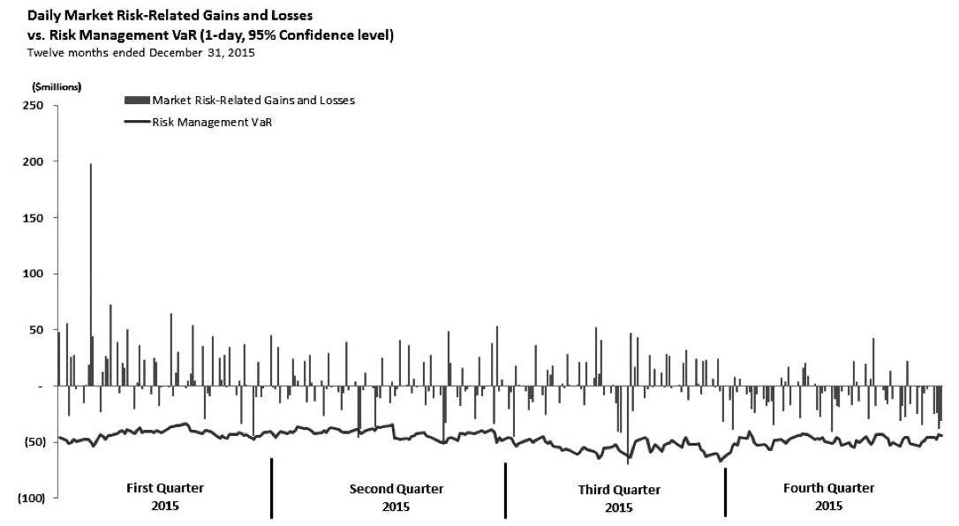


Slide 15
Backtesting
We look at exceptions, i.e. days when loss was greater than VaR.
If the model is valid then the number of exceptions should be in line with the confidence level.
For example, for a 99% 1-day VaR, we would like to have exceptions on 1% of the days
If exceptions occur on more than 1% of days, then we might be underestimating the risk
If exceptions occur on less than 1% of days, then we might be too conservative.

Slide 16
Example
Suppose we back-test 1-day 99% VaR over 600 days, how many days do we expect the loss to be greater than VaR?
Should we reject the model if we observed 9 days where losses were greater than VaR? What about 12?
We are looking for a statistical framework that will tell us how many exceptions are too many or too few.

Slide 17
Actual vs. Hypothetical Returns
Every day, VaR is computed based on the portfolio at the end of the previous day, therefore it measures the potential losses if the portfolio is “frozen” through the day.
In fact, portfolios evolve dynamically through the day.
We observe actual returns, which reflect intraday trades, as well as other profit items.
Ideally, backtesting is done by comparing VaR to each of two types of returns:
Actual returns: Actual profit/loss that was recorded for the portfolio
Hypothetical returns: change in portfolio value assuming no change in portfolio composition

Slide 18
Type 1 vs. Type 2 Errors
 | Model
Decision |  | Correct | Incorrect
 | Accept | OK | Type 2 Error
 | Reject | Type 1 Error | OK
Type 1 error - What is the probability that we reject a correct model?
If that probability is very low reject the model.
Typical hypothesis testing.
Power of a test - What is the probability of rejecting the model when it’s really incorrect?
We need to assume a different model in order to compute this probability.

Slide 19
Statistical Test
To conduct a statistical test we need to determine
H₀: The value of the parameters if the VaR model holds.
A level for the test (not related to the confidence level of the VaR!!), typically 1% or 5%.
What is the probability of observing the historical returns/exceptions given H₀. This is the p-value.
If p-value lower than the level of the test then we reject the model.

Slide 20
H₀ Under a Simple Model
If we assume daily results are serially independent then we have a set of Bernoulli trials.
If the VaR model holds, then the theoretical probability of an exception is p (=1−α), e.g. for VaR_{99%}: p=0.01.
The probability of m or more exceptions in n days is given by the cumulative binomial distribution:

Slide 21
Example – Too many exceptions?
We back-test a 1-day 99% VaR model over 600 days. There are nine days when the loss was greater than the VaR. Should we reject the model?
The probability of 9 or more losses is:
p-value = 1 – BINOMDIST(8,600,0.01,TRUE) = 0.152.
Do not reject at 5% confidence level
What if there were 12 exceptions?
The probability of 12 or more losses is 0.019.
We reject at 5% confidence level

Slide 22
Example - Are we too conservative?
Suppose a bank uses 99% daily VaR.
During the last year there have been no exceptions, i.e. losses were always less than VaR.
The CEO claims that the risk department is too conservative. Is she right?
What is the probability of no exceptions?
p-value = BINOMDIST(0,250,0.01,TRUE) = 0.081
We cannot reject the model at 5% confidence level
For this reason, banks like to backtest VaR at lower levels, e.g. 95%, and apply a multiplicative factor.

Slide 23
Binomial converges to Normal
By the Central Limit Theorem, the Binomial goes to the Normal distribution in the limit.
If we have T trials with a p probability of an exception, then the number of exceptions (x) follows the following:

Slide 24
Z-value test
This leads to a z-value test:
Consider our previous example:
Computed to be a p-value of: 0.0069 → Reject the model

Slide 25
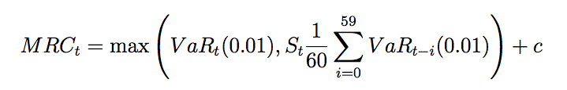
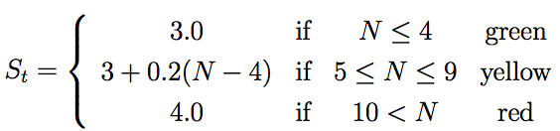
Regulatory VaR for Trading Portfolio
The capital required for market risk in the trading portfolio is based on 99% 10-day VaR, which is usually computed by the bank from 1-day VaR:
The multiplier, S_{t}, is computed based on N, which is the number of daily exceptions over the last 250 trading days.

Slide 26
Type 1 and Type 2 Errors of Regulatory Test
What is the probability of a bank with a correct model to be penalized?
1 – BINOMDIST(4,250,0.01,TRUE) = 10.8%
What is the probability of an incorrect VaR model, with actual 97% confidence, not being penalized?
BINOMDIST(4,250,0.03,TRUE) = 12.8%
The power is 87.2%. Very low power.

Slide 27
Likelihood Ratio Test
We can also apply Likelihood Ratio tests
We test a VaR at confidence level: 1-p.
Suppose we observe x exceptions over T days.
MLE estimator of exception probability is π=x/T
The (unconditional) likelihood ratio test is:
Reject at 5% if LR>3.841
Other rejection boundaries: 6.635 at 1%, 2.706 at 10%

Slide 28
Bunching and conditional coverage
Bunching occurs when exceptions are not evenly spread throughout the back testing period
The serial-independence assumption is invalid
Statistical tests for bunching are based on extension of the likelihood ratio test.
To test for independence, we need to satisfy a model for the dependence, which we are trying to reject. The most common one is a Markovian assumption, i.e. the probability of exception today depends on whether there was an exception yesterday (but not farther back than that).

Slide 29
Conditional Coverage – Christoffersen (1998)
 | Day Before |  | Unconditional
Current Day | No Exception | Exception
No exception | T₀₀ | T₁₀ | T-x
Exception | T₀₁ | T₁₁ | x
Total | T₀ | T₁ | T=T₀+T₁
We count the number of exceptions, and classify them according to whether or not the previous day was also an exception.
π = x/T – unconditional probability of exception in the sample
π₀ = T₀₁/T₀ – conditional probability of exception, given no exception the day before
π₁ = T₁₁/T₁ – conditional probability of exception, given exception the day before

Slide 30
Combining Conditional and Unconditional LR Tests
LR_{ind} is the ratio of likelihood given the Markovian conditional model to the likelihood of the independent observations model.
We can combine it with LR_{uc} to reject both the independence and the unconditional probability of the model:
We reject at 5% if LR > 5.991.

Slide 31
Homework
Generate 250+250 daily returns, mean=0, and volatility follows EGARCH.
Estimate daily VaR at 95% assuming: Normal, mean=0, and:
Volatility based on last 250 days
Volatility based on EWMA, λ=0.97
Back-test using LR unconditional
Back-test using conditional coverage.
Compute power – the probability to reject a false model – i.e. repeat 1000 times and count how often you rejected the false models. How often does the true model get rejected?

Slide 34
Thanks

